Slide 1

6. Regression Trees and Random Forests
Jonathan Hersh (Chapman University Argyros School of Business)

Slide 2
Outline
Regression Trees
Bagging and Ensemble Methods
Random Forests

Slide 3

Regression Trees

Slide 4
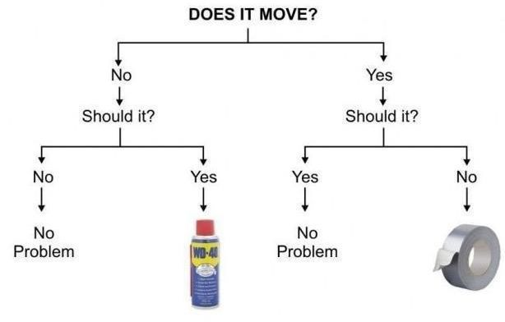
What Are Binary Decision Rules?
Binary decision rules are any rules with only two options!

Slide 5
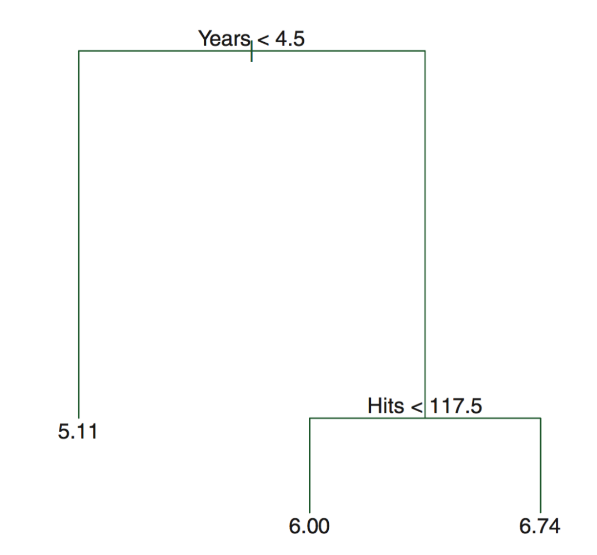
Regression Trees
Tree based methods stratify or segment the predictor space into different regions
Regions are stratified via simple rules
The splitting rules can be summarized into a tree that is very intuitive

Slide 6
Pros and Cons of Trees
Pros
Simple
Easy to interpret
Easy to explain
Can be displayed graphically!
Bagging, boosting, and random forests very powerful (combining trees)
Cons
Slow with large datasets
Not easy to use “out of the box”
Choice of split can be unstable

Slide 7
Decision/Regression Trees
Decision trees can be applied to both regression problems ($y_{i}∈R)$ and classification problems $y_{i}∈\{class1,class2,…,\}$
We’ll consider both

Slide 8
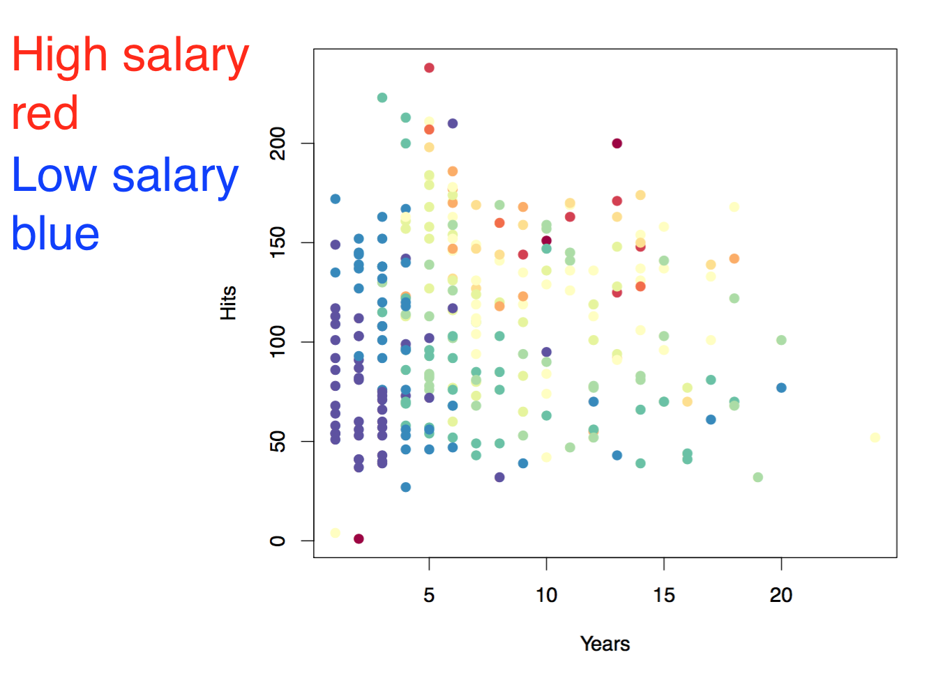
Baseball salary data: how to partition/stratify?

Slide 9
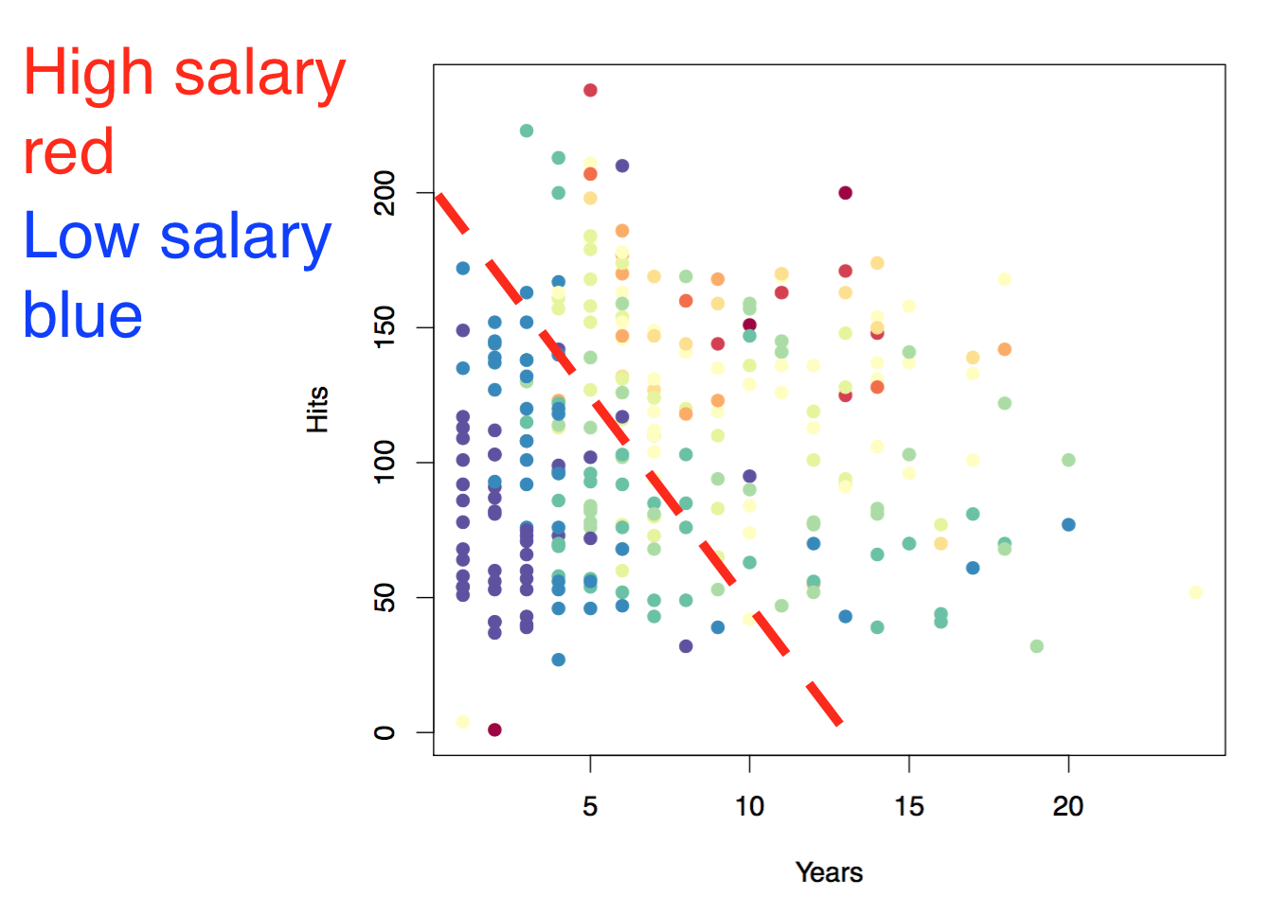
Baseball salary data: how to partition/stratify?

Slide 10
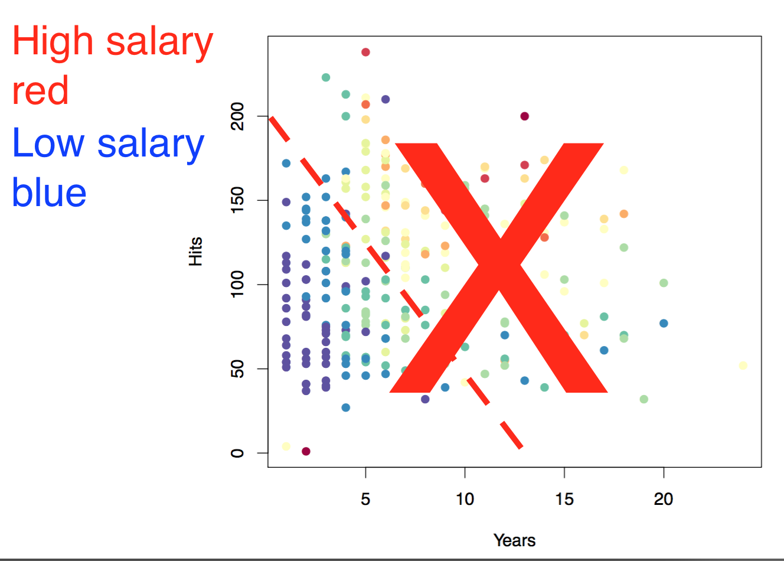
Baseball salary data: how to partition/stratify?
Only linear classification rules are allowed, e.g. year > 10

Slide 11
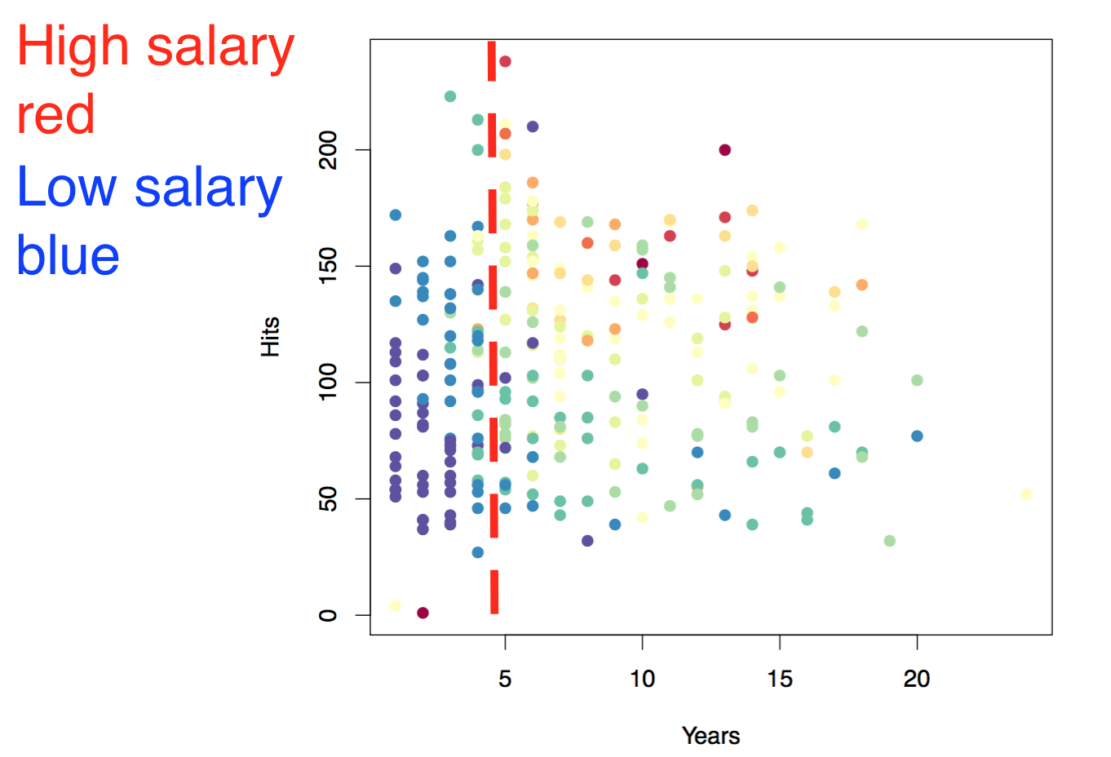
How Regression Trees are Constructed
Every variable and every split is consider.
Chosen split is one which maximizes separation of high and low salaries:
Split 1: years > 4.5

Slide 12
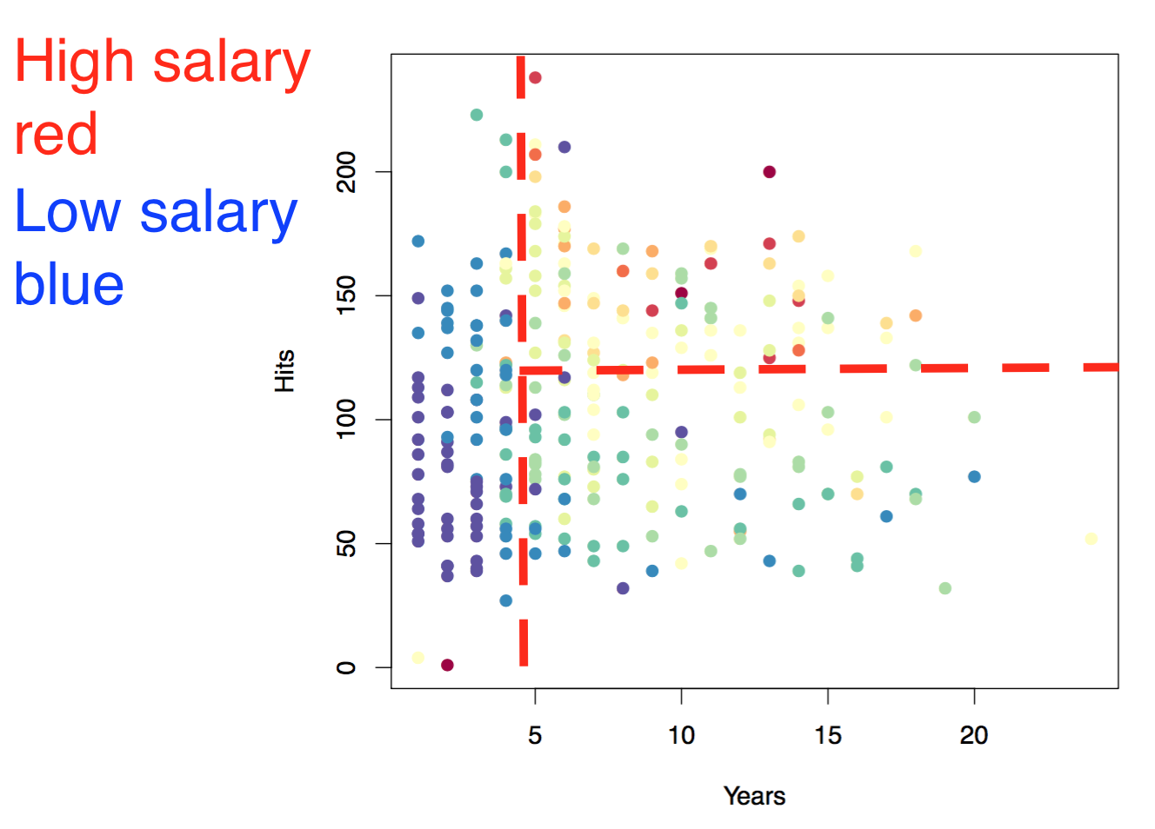

Baseball salary data: split 2
Split 1: years > 4.5
Split 2: hits > 117.5

Slide 13
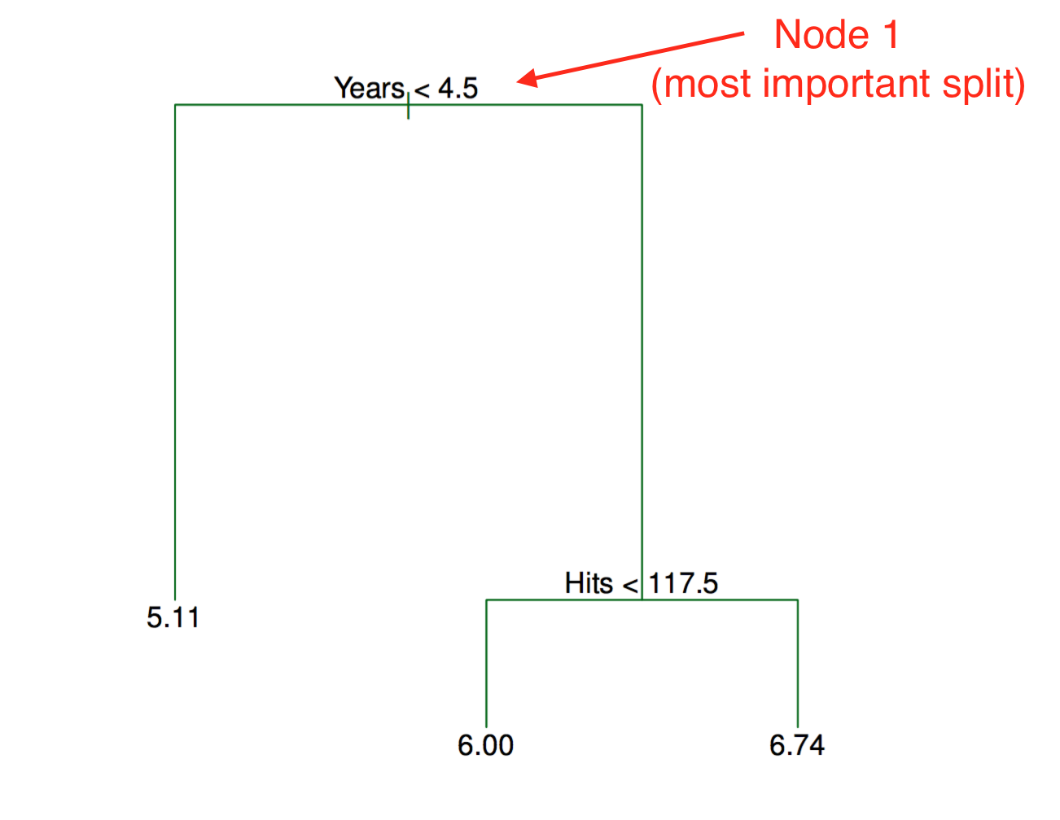
Tree Representation
Trees are read top-down
Most important split is at top
Length represents how much within-cluster variance decreases from split
So Years explains more variance than Hits for this tree

Slide 14
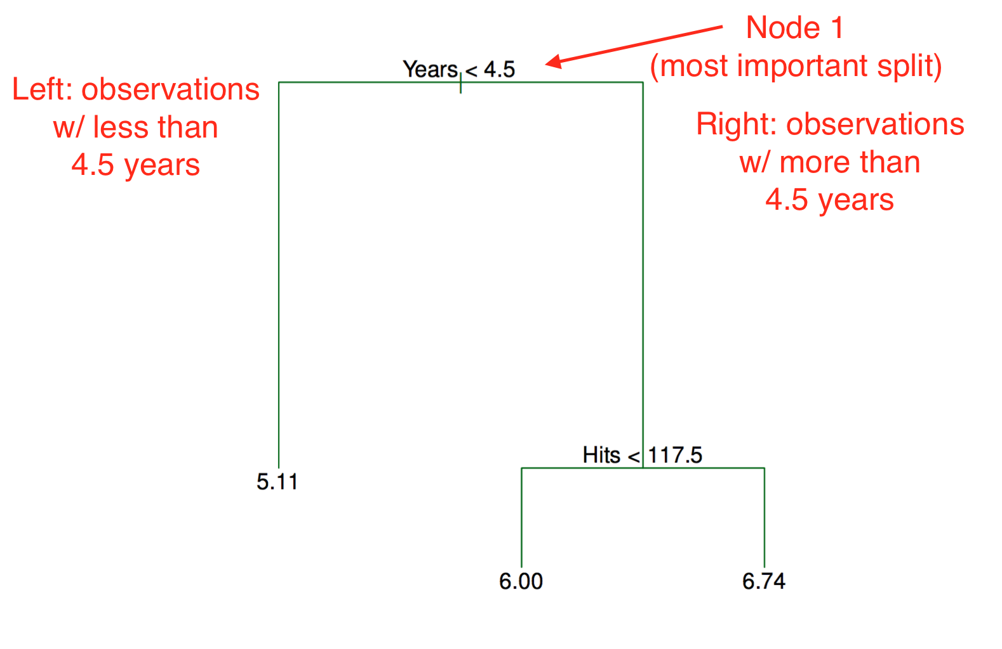
Tree Representation

Slide 15
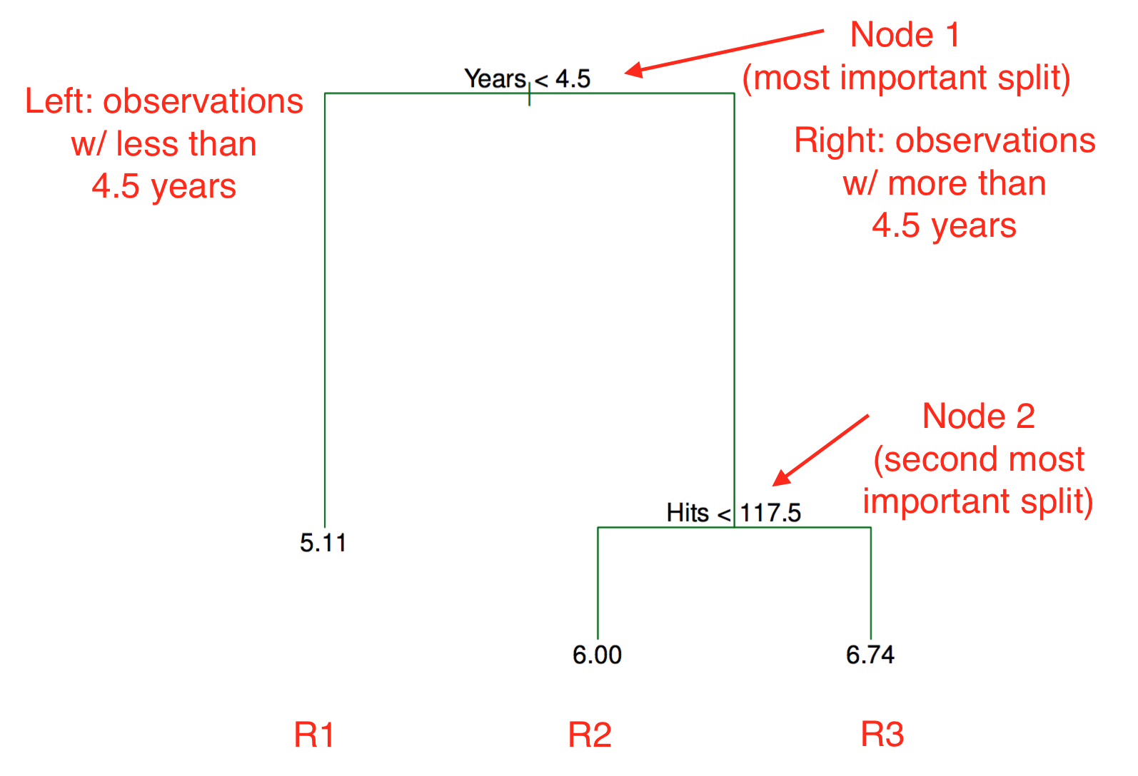
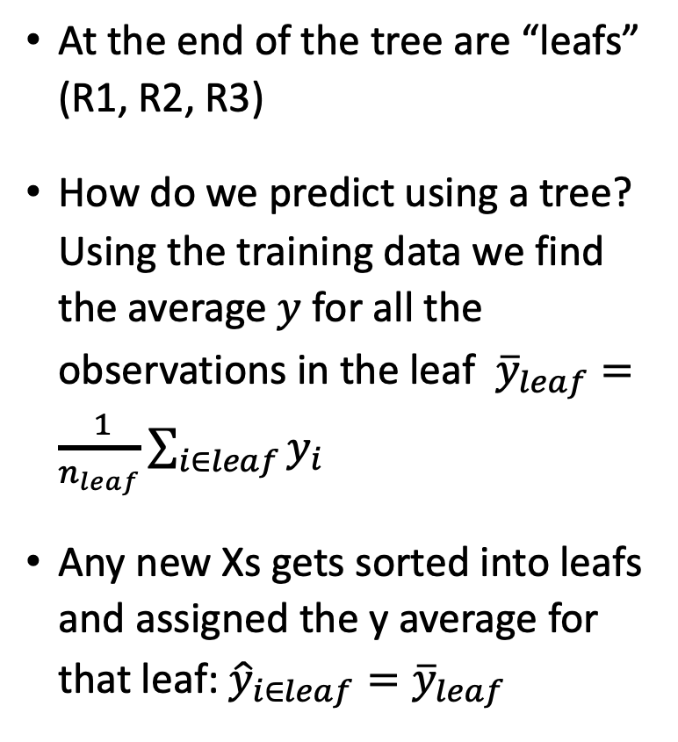
Predictions for Trees? “Leaf” Values
At the end of the tree are “leafs” (R1, R2, R3)
How do we predict using a tree? Using the training data we find the average $y$ for all the observations in the leaf ${\overline{y}}_{leaf}=\frac{ 1}{n_{leaf}}\sum_{i∈leaf}{y_{i}}$
Any new Xs gets sorted into leafs and assigned the y average for that leaf: ${\hat{y}}_{i∈leaf}={\overline{y}}_{leaf}$

Slide 16

Predictions for Trees? “Leaf” Values
$$\hat{y_{k}}=\sum_{i∈k}{{\frac{1}{n_{k}}y}_{i}}$$
$$\hat{y_{k}}=\sum_{i∈k}{{\frac{1}{n_{k}}y}_{i}}$$
$$\hat{y_{k}}=\sum_{i∈k}{{\frac{1}{n_{k}}y}_{i}}$$
Leaf predictions are average values in each partition, k

Slide 17
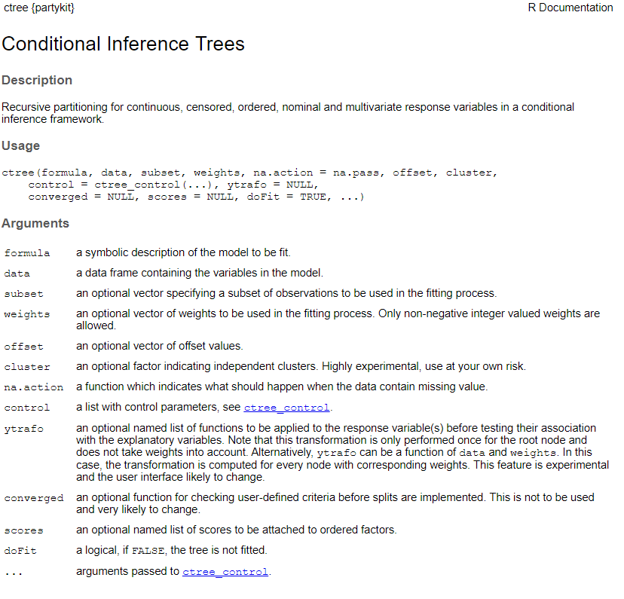
ctree() function in package “partykit” to build regression tree

Slide 18
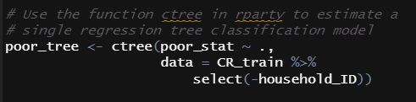
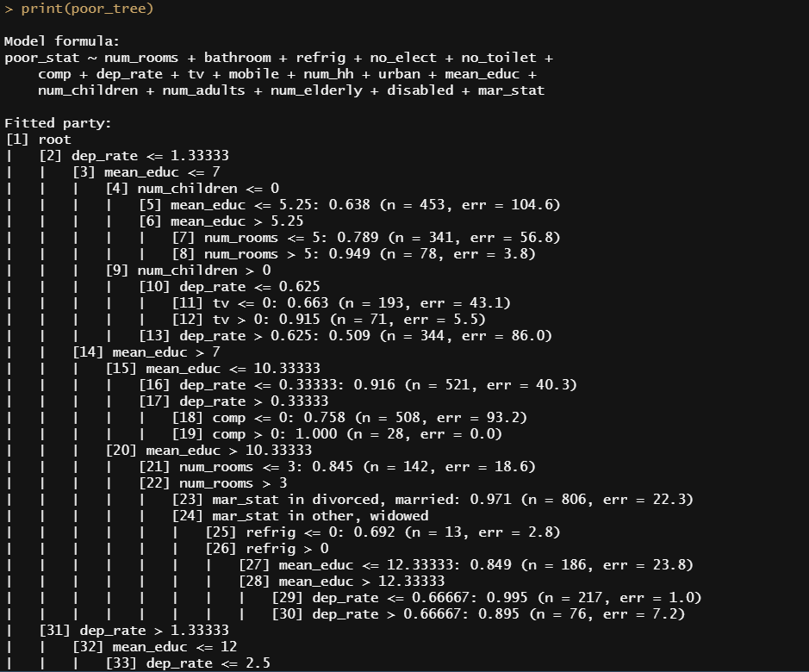
Estimate a tree model to predict titanic survival
ctree() function estimates a regression tree
We need: formula (Y and Xs)
Raw model output isn’t the prettiest to read (but does show fitted model.)

Slide 19
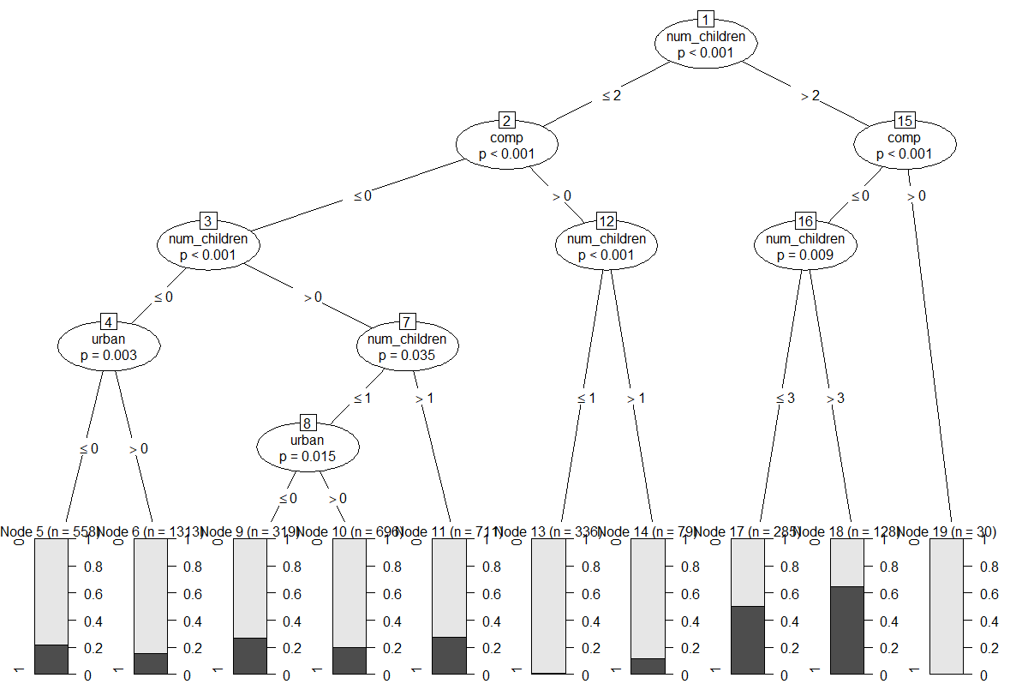
Plot Fitted Regression Tree
First split is shown at top with p-value with null hypothesis that split doesn’t increase class “separation”. Number of children is the most important variable, and p-value shows it improves model fit
Second split is given by successive node. Computer access is the second most important
For each “leaf” at the bottom the distribution plots for the outcome

Slide 20

Pruning trees
How do we know when to stop splitting the data?
Trees with many splits can overfit the data
Solution is to grow a large tree $T_{0}$, then prune it to obtain a smaller sub-tree

Slide 21
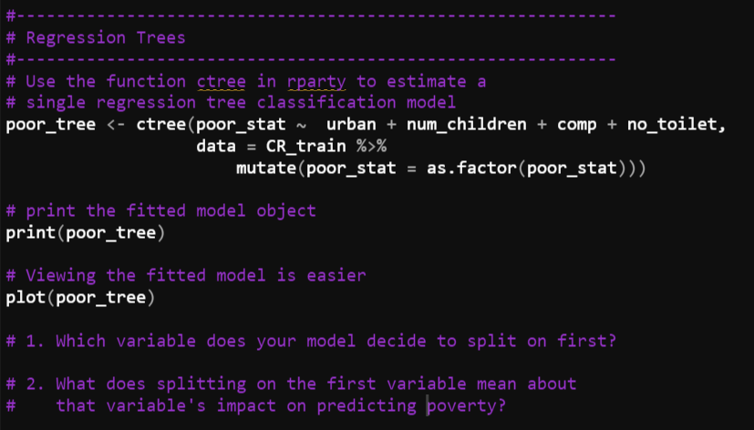
Regression Tree Lab

Slide 22
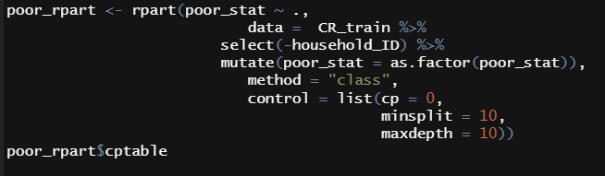
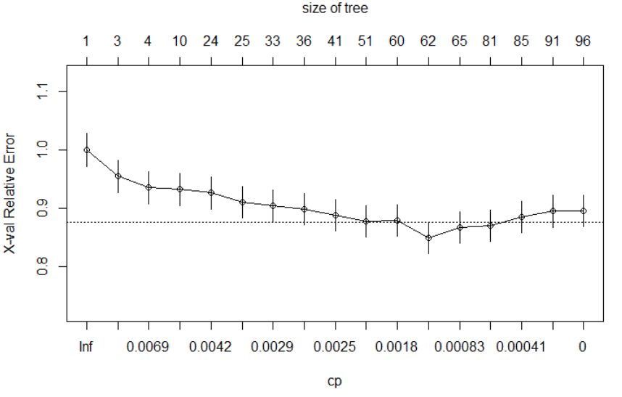
Cross –Validate Our Titanic Data to Determine Optimal Tree Depth

Slide 23
Bagging

Slide 24

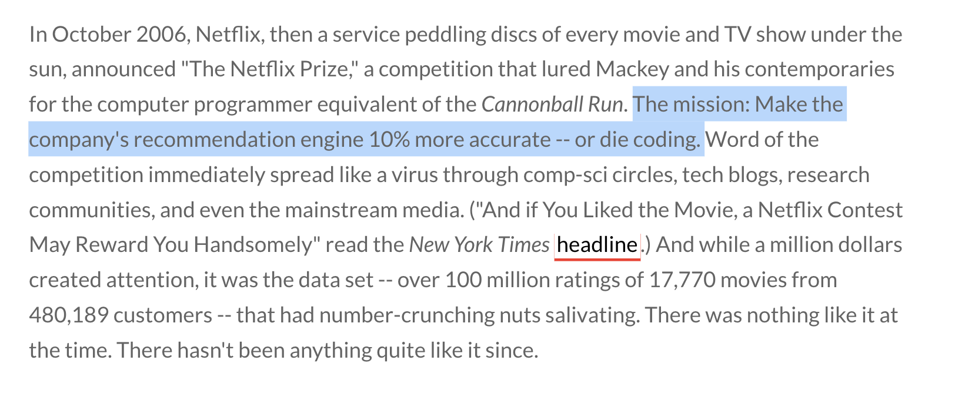
https://www.thrillist.com/entertainment/nation/the-netflix-prize

Slide 25
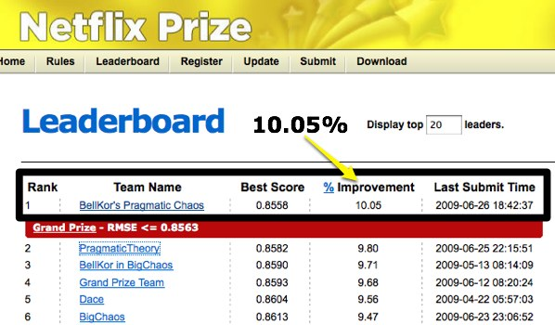
Netflix prize

Slide 26
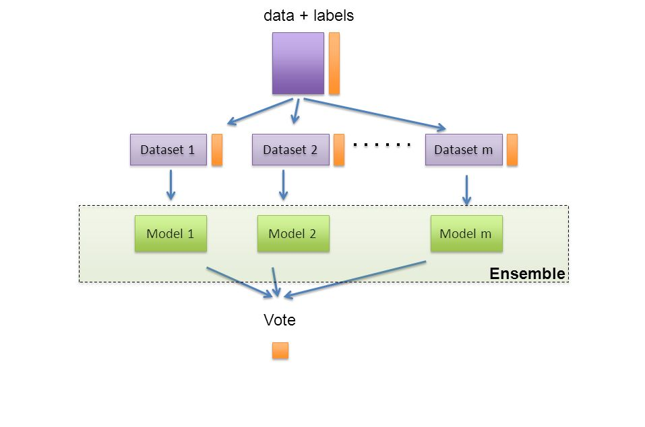

Netflix prize winners
Punchline: simple models beat out one very deep model

Slide 27
Netflix prize conclusion: ensemble of simple methods beats one complex method

Slide 28
Bagging
Bagging is short for bootstrap aggregation
It’s a general purpose method for reducing variance in any machine learning method
With n independent observations, $z_{1},z_{2},…,z_{n}$each with variance $σ^{2}$ , the variance of the mean ($\overline{z}$) is given by $σ^{2}/\overline{z}$
We usually cannot do this because we don’t have multiple training datasets

Slide 29
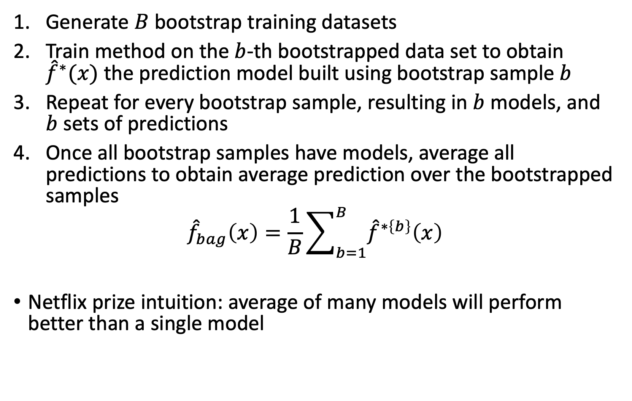
Bagging (Bootstrap Aggregation) Algorithm
Generate $B$ bootstrap training datasets
Train method on the $b$-th bootstrapped data set to obtain ${\hat{f}}^{∗}(x)$ the prediction model built using bootstrap sample $b$
Repeat for every bootstrap sample, resulting in $b$ models, and $b$ sets of predictions
Once all bootstrap samples have models, average all predictions to obtain average prediction over the bootstrapped samples
$${\hat{f}}_{bag}\left(x\right)=\frac{1}{B}\sum_{b=1}^{B}{{\hat{f}}^{∗\left\{b\right\}}\left(x\right)}$$
Netflix prize intuition: average of many models will perform better than a single model

Slide 30
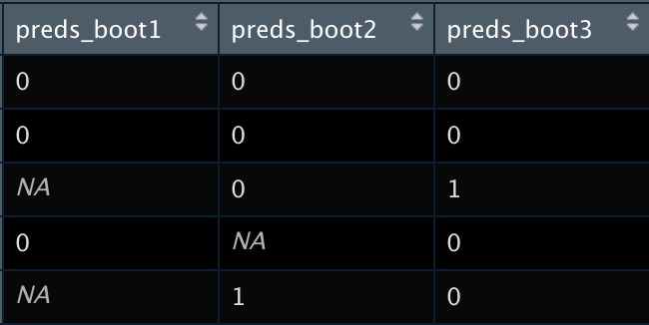

Out-of-bag error
Recall that for each bootstrapped sample b is composed of a subset of the total training data
For each sample, the data not used to fit the model is referred to as out-of-bag (OOB) observations
We can better approximate out of sample error by only using out-of-bag observations for model validation

Slide 31
Random Forests

Slide 32
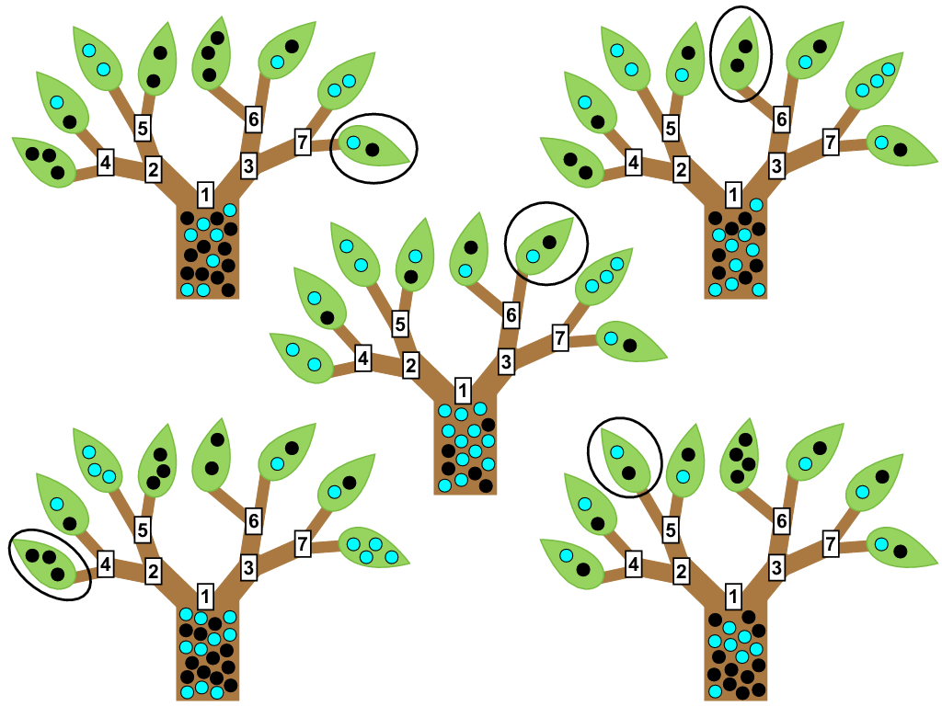
Random Forests
Random forests are a slight trick to bagging that highly improves predictive power
Many trees do poorly because the stepwise greedy algorithm doesn’t fully explore variable and parameter space
Random forests is like bagging, only each time a split in a tree is considered, a random selection of m predictors is chosen as split candidate
A fresh set of m predictors is taken at each split.

Slide 33
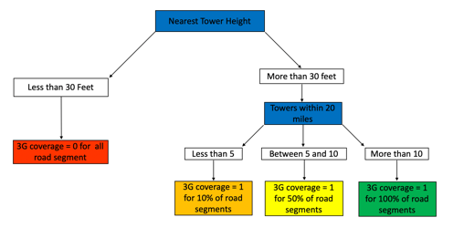
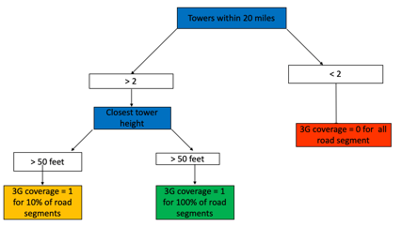
Random Forest Model: Many Decision Trees
B bootstrap
sampes of data
(~ 1000)
…
Bootstrap 1
Bootstrap b
Bootstrap 1000
Tree 1
Tree b
Tree 1000
Vote if household is poor
Vote if household is poor
Vote if household is poor

Slide 34
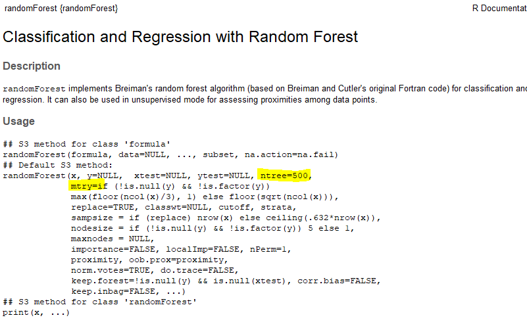
Estimating Random Forest Models Using “randomForest”
Key parameters in the randomForest package:
Mtry: number of variables to randomly select at each candidate node split
Ntree: number of regression or classification trees used to fit total random forest model

Slide 35
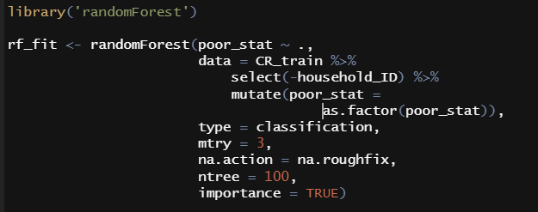
Estimating Random Forest Model Using randomForest() package
Must specify formula and dataset to use per usual
Additionally must specify “mtry” the number of variables to sample (randomly) for each node
Missing values will cause an error and this rough fix replaces them with median values
Ntree specifices the number of trees in the random forest

Slide 36
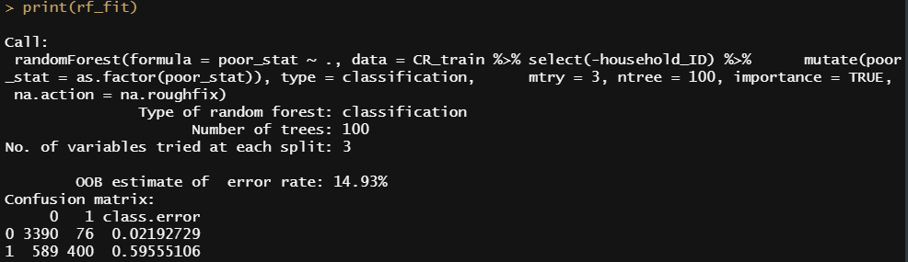
Random Forest Model Object

Slide 37
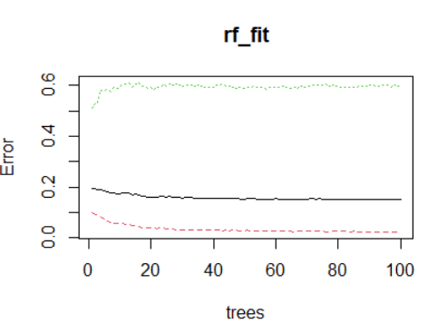
plot() function against rf object – 100 trees, mtry = 3
Green is error rate for positive class, red is error rate for negative class (not poor), and black is overall error rate (all out of bag error)
Error seems to stabilize at 50-100 trees, so we only need around 100 trees for this prediction problem

Slide 38
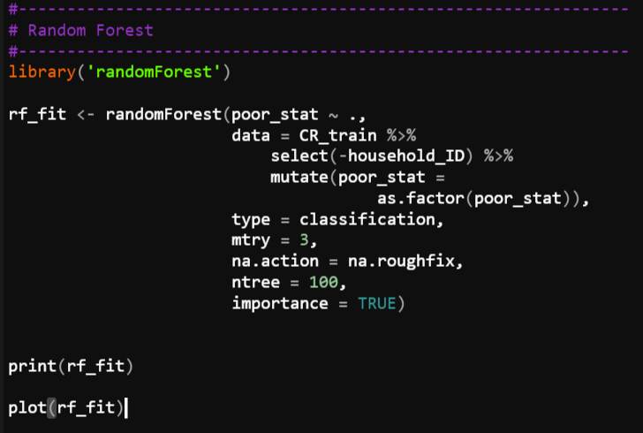
Random Forest Lab

Slide 39
What Is Model Interpretability?
Model interpretability:
“the degree to which a human can understand the cause of a decision” (Miller, 2017)
The higher the interpretability, the easier it is for someone to comprehend why a decision has been made
High Interpretability Models
Linear and smooth relationships
Easy to compute
Few observations okay
Linear regression (OLS)
More interpretable
Decision Trees
Low Interpretability Models
Non-linear relationships
Non-smooth relationships
Need many observations
Long computation time
Interpretability
Random Forests
Neural Networks
Less interpretable
Deep Neural Networks
Less accurate
Accuracy
More accurate

Slide 40





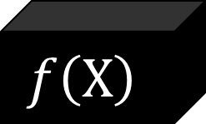
Why Do We Care About Explainable AI?
Consequential decisions may need human validation
Explaining the model may help us build better models
Explainable models might engender more trust
$$f\left(X\right)$$
Introduction
Background and Literature Review
Managerial Context
Experiment
Results
Conclusion

Slide 41
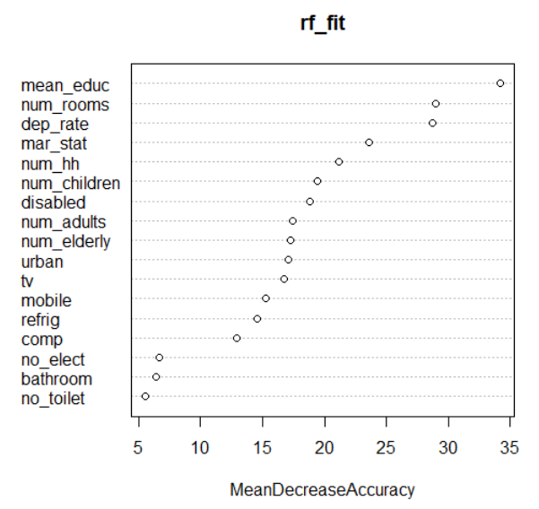
Which Variables Matter Most? Variable Importance
Which variables are most important for the random forest model?
One way of assessing importance is using variable permutation. This replaces a given variable (sequentially) with random noise (e.g. rnorm(., 0,1)) and re-estimates the model.
Logic: more “important” variables result in worse models when these variables are absent (or are random noise)
varImpPlot(rf_fit) plots these importance measures
Mean educ is most important, followed by number of rooms, then dep rate

Slide 42
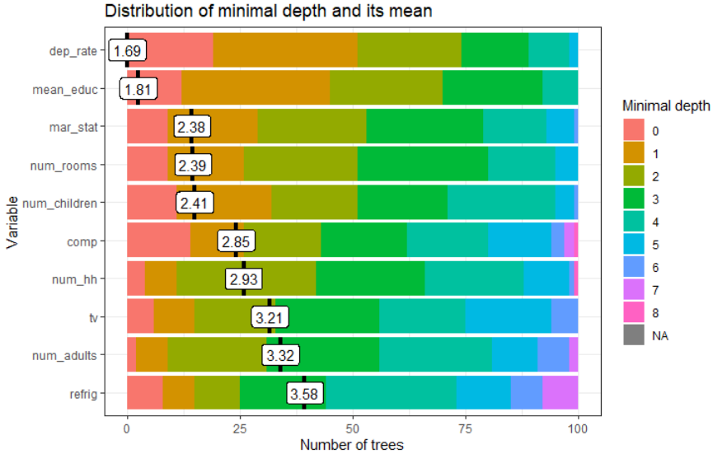
randomForestExplainer
Random forest explainer is a package that has many useful functions to explain and open up the random forest black box.
This plots the average depth of trees in the ensemble that use these variables

Slide 43
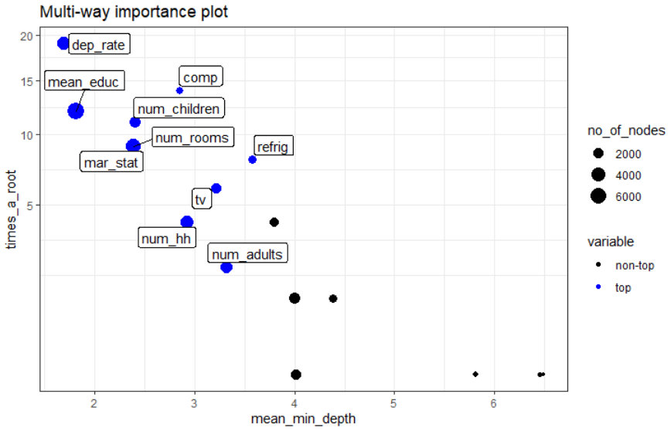
randomForestExplainer

Slide 44
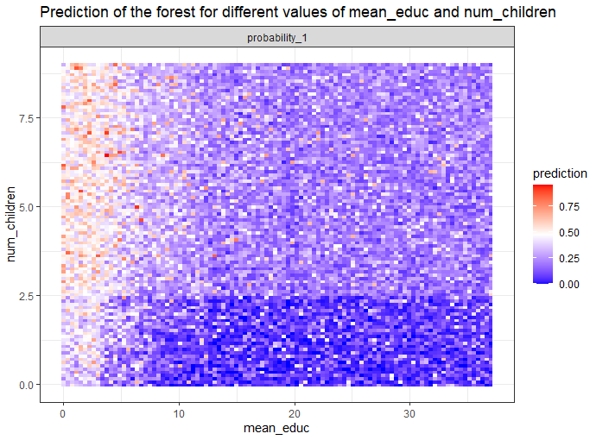
randomForestExplainer
We can see how the random forest classifies households with different characteristics of average education and number of children

Slide 45
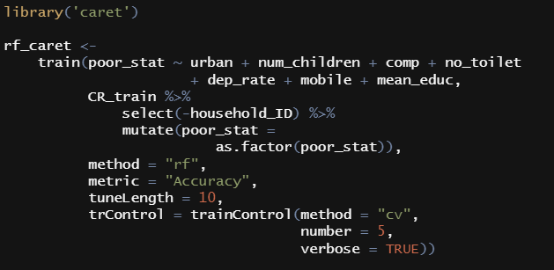
Cross-Validating to Select mtry in caret
caret is a great machine learning package that holds many models.
It handles many common machine learning tasks such as cross-validation to select optimal paramters

Slide 46
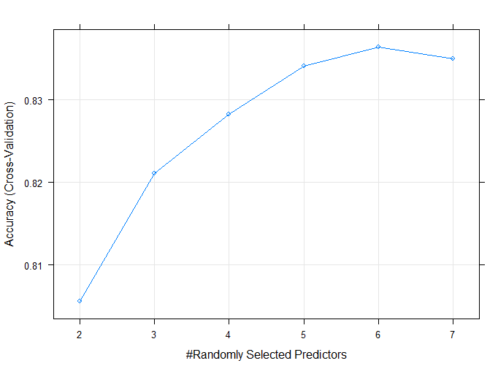
Cross-Validating to Select mtry in caret
It seems we should set mtry = 6!

Slide 47
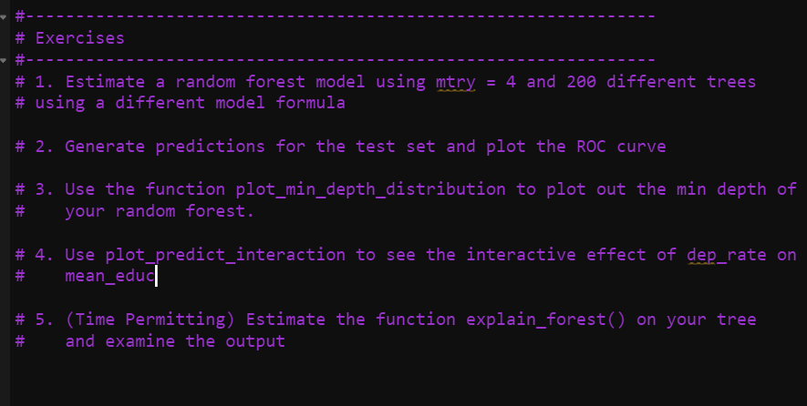
Random Forest Lab 2

